Slide 1
Midterm Review
Feb.06.2015

Slide 2
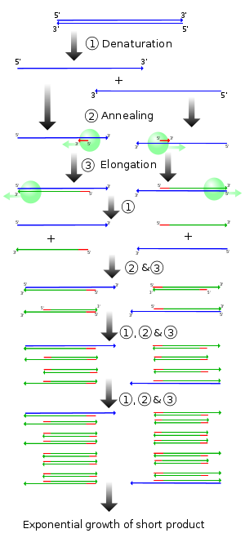
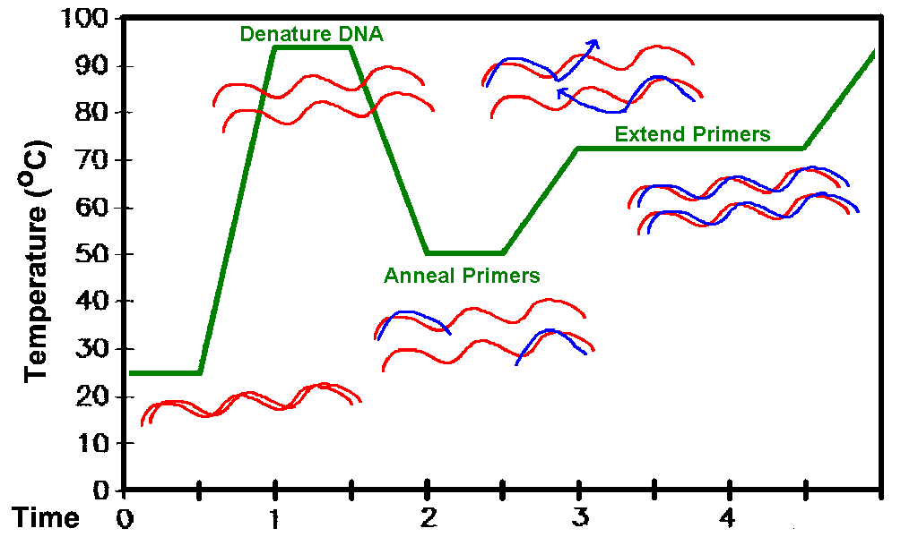
Polymerase Chain Reaction (PCR)

Slide 3
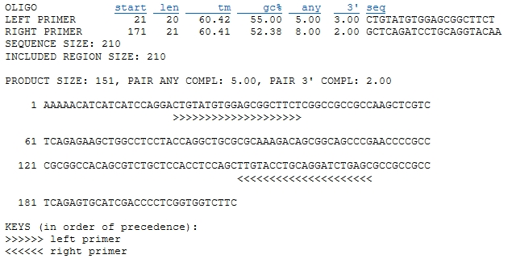
Polymerase Chain Reaction (PCR)

Slide 4
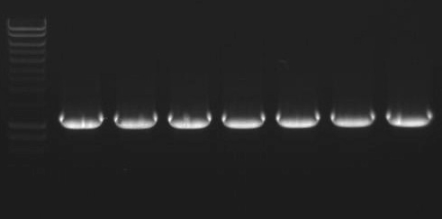
Loading controls for PCR

Slide 5
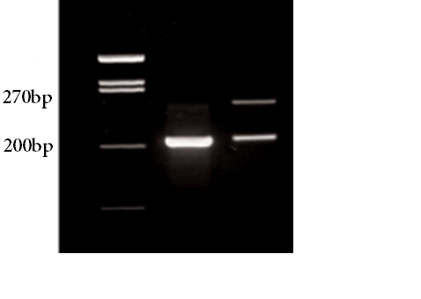
Polymerase Chain Reaction (PCR)
Markers
Sample1
Sample2
Band1 ~ 200bp
Band2: ~270bp
after incorporation of ~70bp sequence
Extract the 270bp band for cloning

Slide 6
Polymerase Chain Reaction (PCR)
Markers
Sample1
Sample2
Band1 ~ 200bp
Band2: ~270bp
after incorporation of ~70bp sequence
Extract the 270bp band for cloning

Slide 7
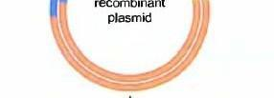
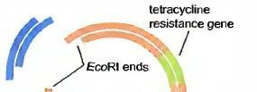
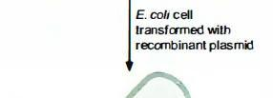
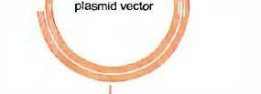
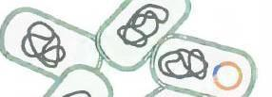
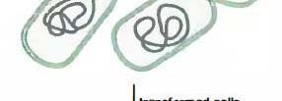
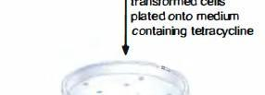
Cloning

Slide 8
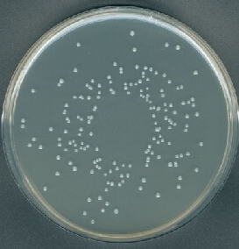
Cloning – Actual E.coli plate

Slide 9
Cloning – Actual E.coli plate

Slide 10
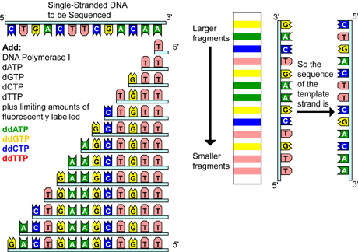
Sanger Sequencing
http://www.daviddarling.info/encyclopedia/D/DNA_sequencing.html

Slide 11
Sanger sequencing result
Each colored peak corresponds to a single nucleotide at a specific position within the DNA
There is one peak per position

Slide 12
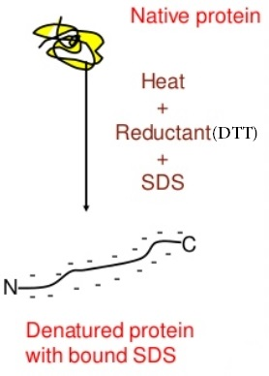
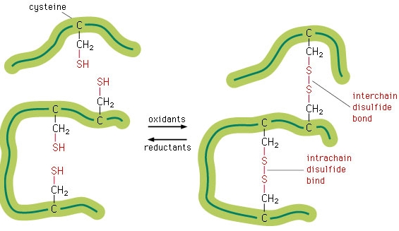
Western Blot – Sample Preparation

Slide 13
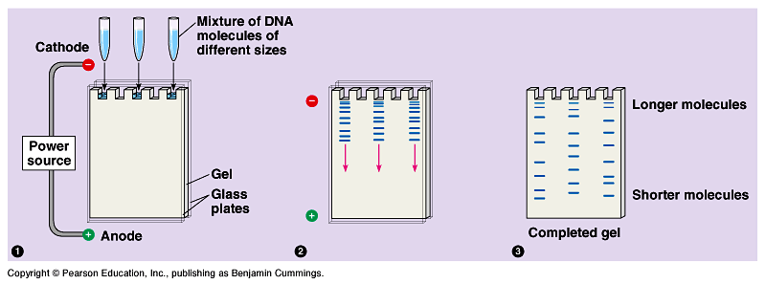
Western Blot – Gel Electrophoresis

Slide 14
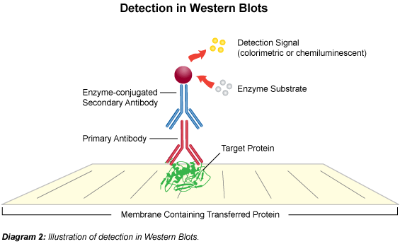
Western Blot - Detection

Slide 15
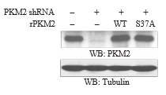
Western Blot – The actual bands
Band intensity corresponds to the amount of protein
Antibody against specific protein (here, PKM2)
Tubulin protein level used as a control

Slide 16
Western Blot – The actual bands
Detection of modified proteins is also possible
No difference in ERK protein levels
But there is difference between phospho-ERK levels

Slide 17
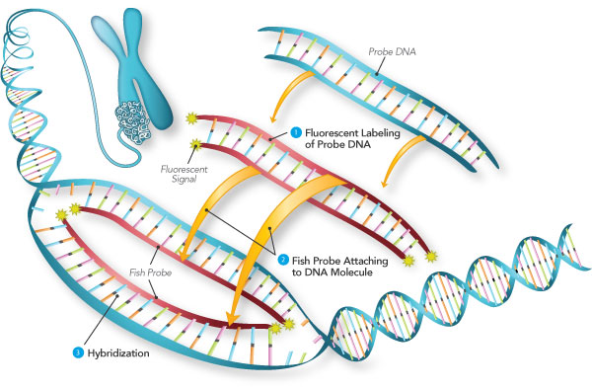
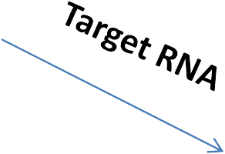
Fluorescence in situ hybridization (FISH)
http://www.semrock.com/fish.aspx
-Single or double stranded probes may be used. -Definitely use single stranded probes when targeting RNA.
-The probes have to be reverse complementary to the target regions.

